Slide 1
INTRODUCTION TO PSYCHOLOGY
Sumitava Mukherjee
sm1@hss.iitd.ac.in
Read: https://nobaproject.com/modules/thinking-like-a-psychological-scientist

Slide 2
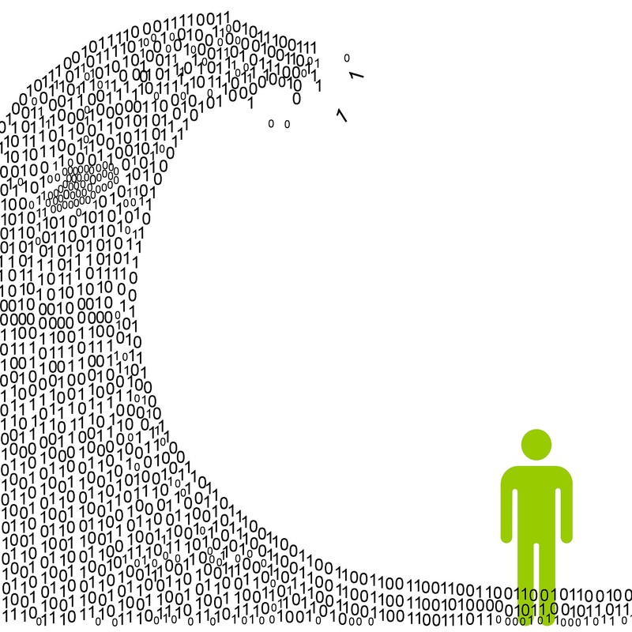
Today, people are overwhelmed with information although it varies in quality.
[Image: Mark Smiciklas, https://goo.gl/TnZCoH, CC BY-NC 2.0, https://goo.gl/AGYuo9]
2

Slide 3
Why do people ?
Yawn
Hunt
Make decision errors
Help each other
Decide about complex problems like purchasing a car or house
3

Slide 4
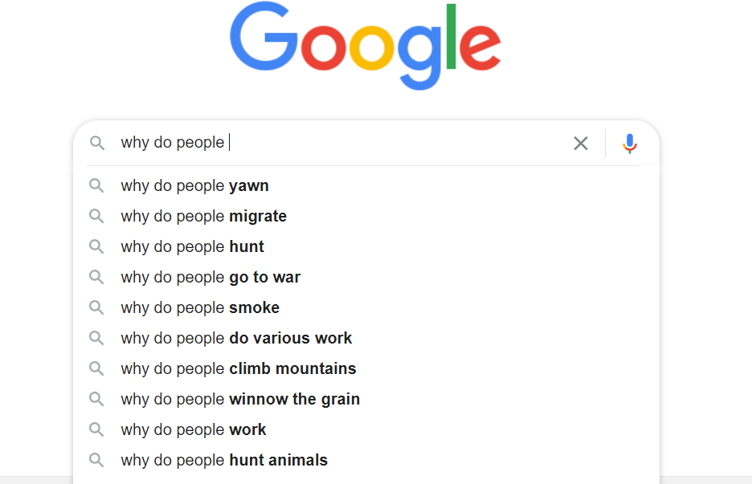
Living in a world of information
© Google Inc.
4

Slide 5
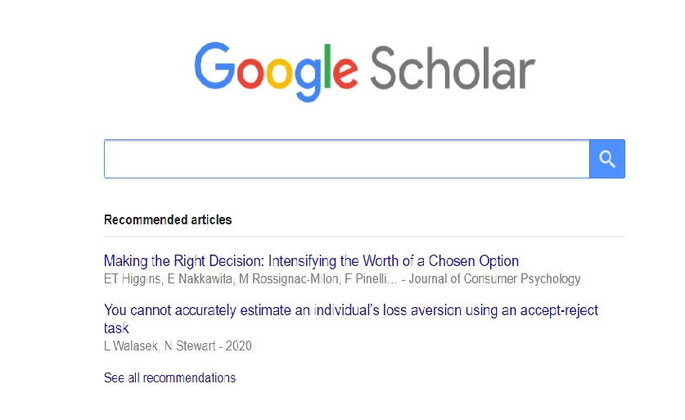
Knowledge (and the illusion of knowing)
The mind is prone to find cause-effect relationships
A belief in coherence (and a good story)
Source credibility
Quantity vs Quality
Fake news, click baits, etc. Compete for attention with well-informed scientific evidence
Lay theories of everything
Turning to experts (but some are still biased)
Turning to Science as The best bet : Empirical findings
5

Slide 6
Reasoning: Scientific vs Lay (everyday)
Everyday type : Dogs have better memory than kids
Science type: Dogs tend to show recollection of location cues even after 1 month
Method of induction: Draw conclusions based on specific observations
How many observations? Under what contexts? With whom? Where? What was measured? Issues with measurement ? Possible CONFOUNDS? REPLICABLE?
6

Slide 7
Is it good to memorize just before the test?
Does cramming for a test improve performance? Immediate memory? Extended memory?
Introspection: Own experiences
Anecdotal: Experiential stories from a couple of friends
Scientific research: Conduct a study on two groups (cramming vs spaced out reading) and measure different kinds of memory and knowledge
Both rely on a SAMPLE of observations
7

Slide 8
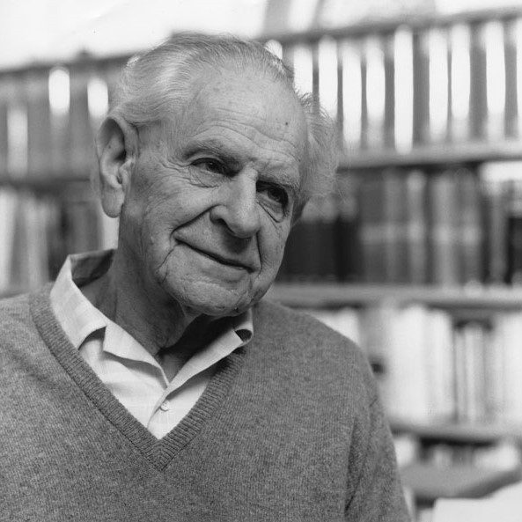
Testing scientific claims
Karl Popper
A good theory should be:
Accurate (Explanations and theories should match real world observations)
Consistent (Few exceptions and clear boundary within which it should work and predict)
Scope (how much broad or narrow is the explanatory power)
Simplicity (When multiple explanations exist, the simplest should be chosen)
Fruitfulness (Usefulness to guide future research and predictions)
FALSIFIABILITY
Scientific claims can be falsified (While many other everyday claims cannot be or are too costly to check)
“People can be taught to move objects by focusing one’s mind on it”
8

Slide 9
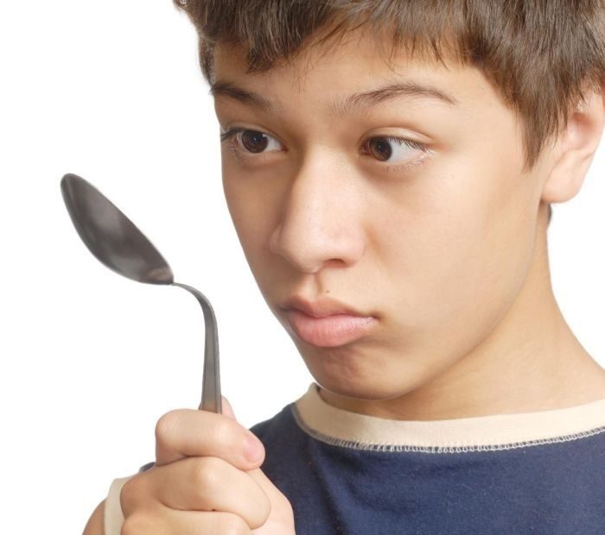
Magic
9

Slide 10
Excercise
Which of the following hypotheses can be falsified? For each, be sure to consider what kind of data could be collected to demonstrate that a statement is not true.
A. Chocolate tastes better than pasta.
B. We live in the most violent time in history.
C. Time can run backward as well as forward.
D. There are planets other than Earth that have water on them.
10

Slide 11
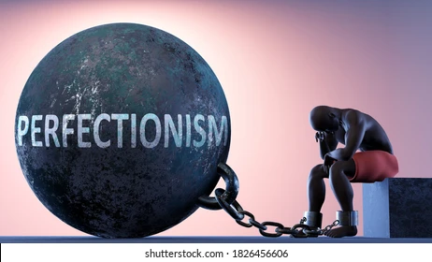
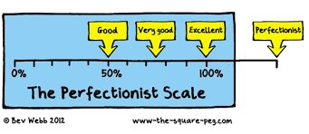
11

Slide 12
How to find the reason for car accidents?
Explore all possible causes
Understanding possible when all explanations have been explored and falsified
Ex: Does sandals versus shoes contribute to increased chance of accidents?
Ex: Does using mobile phones contribute to increased chance of accidents?
Why?
What does that say about how our mind works?
12

Slide 13
Objectivity vs subjectivity
Is psychology a science?
Is psychology subjective?
Is psychological science a “science”?
Is earth science a “science”?
The reliance of inter-subjectivity in psychology and social science
13

Slide 14
Is/can science be truly objective?
All of science is informed by values, Nothing is completely objective (Thomas Kuhn)
Scientists are humans and hence influenced by values, personal/cultural variables, experiences, opinions, beliefs, etc.
There is a difference between FACTS (information about the world) and VALUES (Beliefs about the way the world is or should be).
14

Slide 15
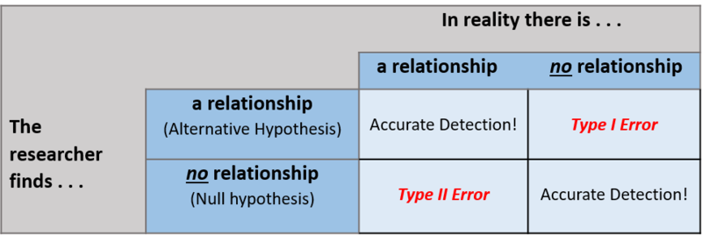
Issues with measurement
(C) Erin I. Smith. http://noba.to/nt3ysqcm CC-BY-NC-SA 4.0 License.
15

Slide 16
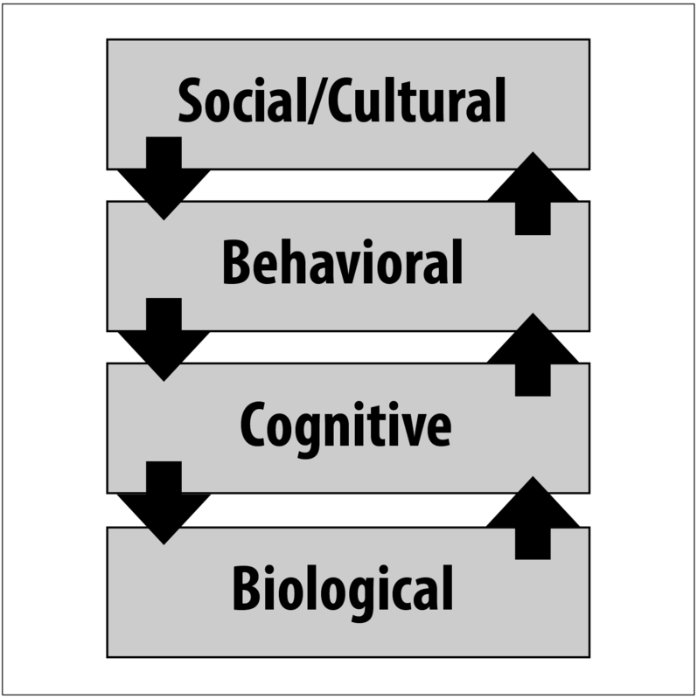
Studying a psychological phenomena
Levels of analysis
Example: Cramming for test
How presence of others or teachers matter, family structure, cultural norms of learning, schooling systems
How long is the study period, What is the time table, Social stress
What information is attended to, memory traces and models, ability to focus, decision strategies
Brain areas/processes (via fMRI), Genetic markup, Neuronal connections, Different biochemical pathways in the brain
16

